Slide 1
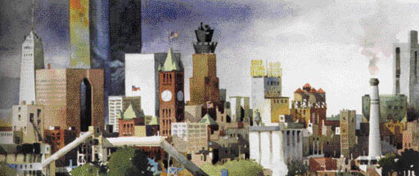

PowerPoint® Lecture Presentation
to accompany
Principles of Economics, Third Edition
N. Gregory Mankiw
Prepared by Mark P. Karscig, Central Missouri State University.

Slide 2
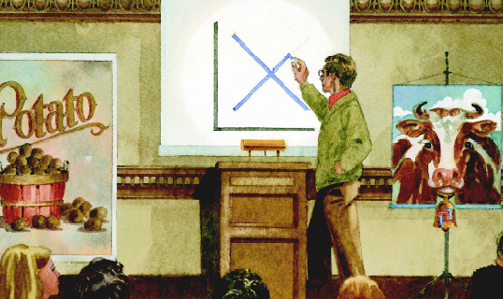
1
INTRODUCTION

Slide 3
1
Ten Principles of Economics

Slide 4
Economy. . .
. . . The word economy comes from a Greek word for “one who manages a household.”

Slide 5
TEN PRINCIPLES OF ECONOMICS
A household and an economy
face many decisions:
  Who will work?
  What goods and how many of them should be produced?
  What resources should be used in production?
  At what price should the goods be sold?

Slide 6
TEN PRINCIPLES OF ECONOMICS
Society and Scarce Resources:
  The management of society’s resources is important because resources are scarce.
  Scarcity. . . means that society has limited resources and therefore cannot produce all the goods and services people wish to have.

Slide 7
TEN PRINCIPLES OF ECONOMICS
Economics is the study of how society manages its scarce resources.

Slide 8
TEN PRINCIPLES OF ECONOMICS
How people make decisions.
  People face tradeoffs.
  The cost of something is what you give up to get it.
  Rational people think at the margin.
  People respond to incentives.

Slide 9
TEN PRINCIPLES OF ECONOMICS
How people interact with each other.
  Trade can make everyone better off.
  Markets are usually a good way to organize economic activity.
  Governments can sometimes improve economic outcomes.

Slide 10
TEN PRINCIPLES OF ECONOMICS
The forces and trends that affect how the economy as a whole works.
  The standard of living depends on a country’s production.
  Prices rise when the government prints too much money.
  Society faces a short-run tradeoff between inflation and unemployment.

Slide 11

Principle #1: People Face Tradeoffs.
“There is no such thing as a free lunch!”

Slide 12
Principle #1: People Face Tradeoffs.
To get one thing, we usually have to give up another thing.
  Guns v. butter
  Food v. clothing
  Leisure time v. work
  Efficiency v. equity
Making decisions requires trading
off one goal against another.

Slide 13
Principle #1: People Face Tradeoffs
Efficiency v. Equity
  Efficiency means society gets the most that it can from its scarce resources.
  Equity means the benefits of those resources are distributed fairly among the members of society.
Notes:
9

Slide 14
Principle #2: The Cost of Something Is What You Give Up to Get It.
Decisions require comparing costs and benefits of alternatives.
  Whether to go to college or to work?
  Whether to study or go out on a date?
  Whether to go to class or sleep in?
The opportunity cost of an item is what you give up to obtain that item.
Notes:
10

Slide 15


Principle #2: The Cost of Something Is What You Give Up to Get It.
LA Laker basketball star Kobe Bryant chose to skip college and go straight from high school to the pros where he has earned millions of dollars.
Notes:
10

Slide 16
Principle #3: Rational People Think at the Margin.
Marginal changes are small, incremental adjustments to an existing plan of action.
People make decisions by comparing costs and benefits at the margin.
Notes:
11

Slide 17
Principle #4: People Respond to Incentives.
Marginal changes in costs or benefits motivate people to respond.
The decision to choose one alternative over another occurs when that alternative’s marginal benefits exceed its marginal costs!
Notes:
12

Slide 18
Principle #5: Trade Can Make Everyone Better Off.
People gain from their ability to trade with one another.
Competition results in gains from trading.
Trade allows people to specialize in what they do best.
Notes:
15

Slide 19
Principle #6: Markets Are Usually a Good Way to Organize Economic Activity.
A market economy is an economy that allocates resources through the decentralized decisions of many firms and households as they interact in markets for goods and services.
  Households decide what to buy and who to work for.
  Firms decide who to hire and what to produce.
Notes:
16

Slide 20
Principle #6: Markets Are Usually a Good Way to Organize Economic Activity.
Adam Smith made the observation that households and firms interacting in markets act as if guided by an “invisible hand.”
  Because households and firms look at prices when deciding what to buy and sell, they unknowingly take into account the social costs of their actions.
  As a result, prices guide decision makers to reach outcomes that tend to maximize the welfare of society as a whole.
Notes:
16

Slide 21
Principle #7: Governments Can Sometimes Improve Market Outcomes.
Market failure occurs when the market fails to allocate resources efficiently.
When the market fails (breaks down) government can intervene to promote efficiency and equity.
Notes:
17

Slide 22
Principle #7: Governments Can Sometimes Improve Market Outcomes.
Market failure may be caused by
  an externality, which is the impact of one person or firm’s actions on the well-being of a bystander.
  market power, which is the ability of a single person or firm to unduly influence market prices.
Notes:
18

Slide 23
Principle #8: The Standard of Living Depends on a Country’s Production.
Standard of living may be measured in different ways:
  By comparing personal incomes.
  By comparing the total market value of a nation’s production.
Notes:
21

Slide 24
Principle #8: The Standard of Living Depends on a Country’s Production.
Almost all variations in living standards are explained by differences in countries’ productivities.
Productivity is the amount of goods and services produced from each hour of a worker’s time.
Notes:
21

Slide 25
Principle #8: The Standard of Living Depends on a Country’s Production.
Standard of living may be measured in different ways:
  By comparing personal incomes.
  By comparing the total market value of a nation’s production.
Notes:
21

Slide 26
Principle #9: Prices Rise When the Government Prints Too Much Money.
Inflation is an increase in the overall level of prices in the economy.
One cause of inflation is the growth in the quantity of money.
When the government creates large quantities of money, the value of the money falls.
Notes:
23

Slide 27
Principle #10: Society Faces a Short-run Tradeoff Between Inflation and Unemployment.
The Phillips Curve illustrates the tradeoff between inflation and unemployment:
Inflation ⇨ Unemployment
It’s a short-run tradeoff!
Notes:
24

Slide 28
Summary
When individuals make decisions, they face tradeoffs among alternative goals.
The cost of any action is measured in terms of foregone opportunities.
Rational people make decisions by comparing marginal costs and marginal benefits.
People change their behavior in response to the incentives they face.

Slide 29
Summary
Trade can be mutually beneficial.
Markets are usually a good way of coordinating trade among people.
Government can potentially improve market outcomes if there is some market failure or if the market outcome is inequitable.

Slide 30
Summary
Productivity is the ultimate source of living standards.
Money growth is the ultimate source of inflation.
Society faces a short-run tradeoff between inflation and unemployment.

